Slide 1
Data Modeling
Munish Arora
Data Modeling
Analyze and define different entities as well as the relationships between them.

Slide 2
Power BI Overview
What is Data Model
Conceptual
Logical and
Physical Data Model
Star vs Snowflake Schema
Configure Table and Column Properties
Date Table
Relationship Cardinality
One-one, one-many, many-one, many-many
Creating Hierarchies

Slide 3

Lesson 1: Data Model

Slide 4
What is Data Modeling
There are 3 main stages in Data Modeling:
Conceptual Data Model: The data requirements are initially recorded as a conceptual data model. For example customer information is required to be stored.
Logical Data Model: The conceptual model is then translated into a logical data model, which documents structures of the data that can be implemented in databases.
Physical Data Model: The last step in data modeling is transforming the logical data model to a physical data model that organizes the data into tables, and accounts for access, performance and storage details.
Data modeling, there by, defines not just data elements, but also their structures and relationships between them

Slide 5
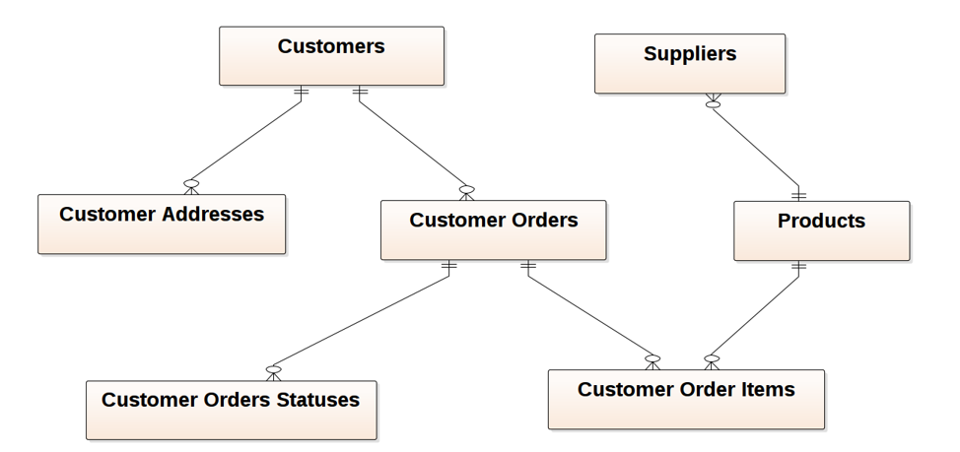
Conceptual Data model
This model
is a structured business view of the data required to support business processes, record business events, and track related performance measures.
focuses on identifying the data used in the business but not its processing flow or physical characteristics.

Slide 6
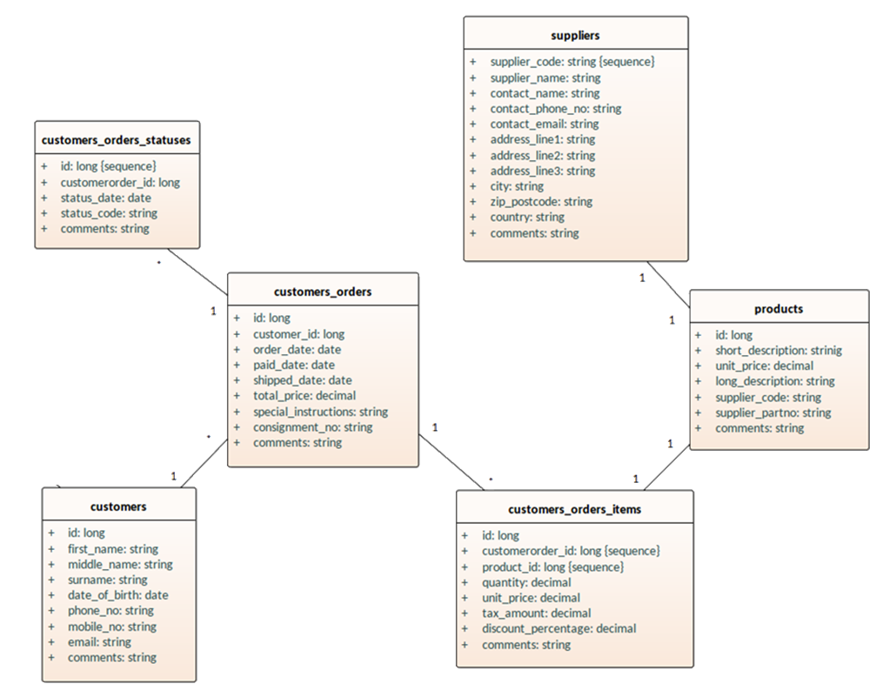
Logical Data model
A logical data model
Establishes the structure of data elements and relationships among them.
Takes elements of conceptual data modeling a step further by adding more information to them.

Slide 7
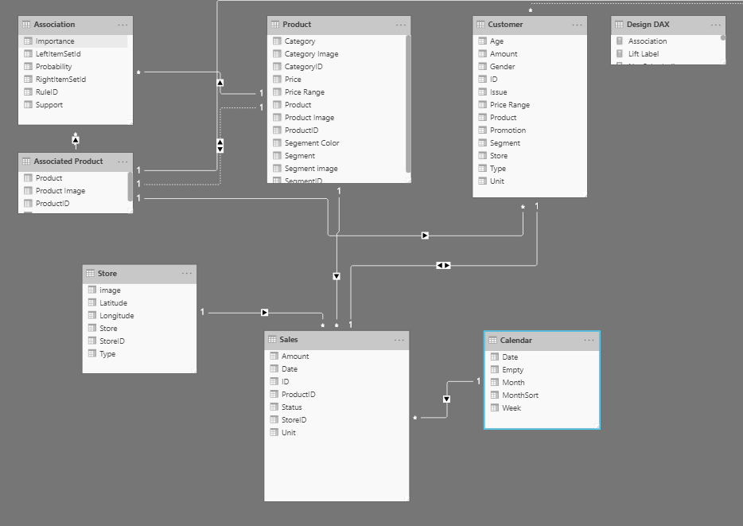
Physical Data Model
A physical data model
is a database-specific model that represents relational data objects (for example, tables, columns, primary and foreign keys) and their relationships .
Represents how the model will be built in the database.
Can be used to generate DDL statements which can then be deployed to a database server.

Slide 8
Lesson 2: Schema
The logical structure of the tables used for reporting in Power BI is known as the schema of the data model.

Slide 9
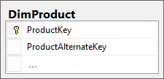


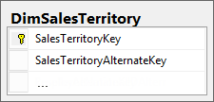
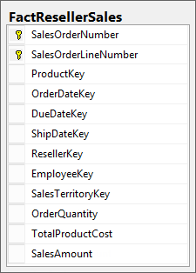
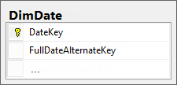
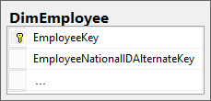
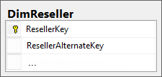
Star Schema
Tables are classified as dimension or fact tables:
Fact: Store observations or events.
Dimension: Describes business entities.
∑

Slide 10
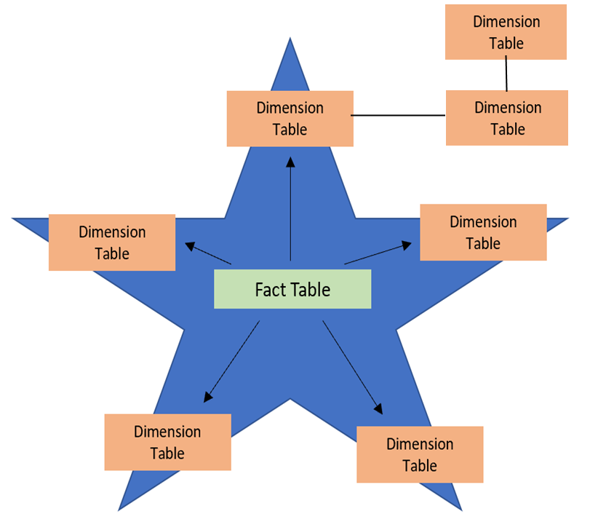
Snowflake Schemas
A snowflake schema is a variation of the star schema.
Dimensions in snowflake schema are stored in multiple related dimension tables
The purpose of a snowflake schema is to normalize the denormalized data in a star schema.

Slide 11
Star vs Snowflake Schemas
Which one to choose?
On one hand, star schemas are simpler, run queries faster, and are easier to set up.
On the other hand, snowflake schemas are less prone to data integrity issues, are easier to maintain, and utilize less space.
Based on the tradeoffs above, it depends on which advantage (or disadvantage) best suits your business use cases.

Slide 12
Knowledge Check
Q01 – Which are two types of tables in a star schema ?
A. Fact B. Dimensions C. Measures C. Columns
A01 – A.Fact ,B. Dimensions
Q02 – What is the difference between a fact table and a dimension table?
A02 – Fact tables store observations or events while dimension tables contain information about specific entities within the data.

Slide 13
Lesson 2: Working With Tables

Slide 14
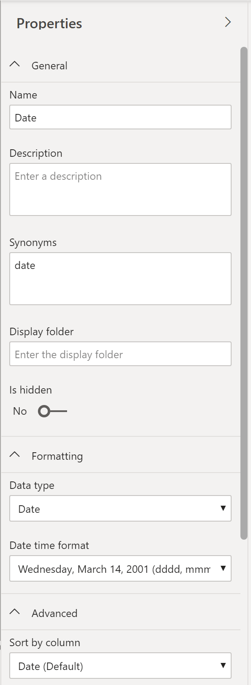
Configure Table and Column Properties
Before working on reports, ensure your model and table structure are simplified.
A simple table structure will be easy to navigate.

Slide 15
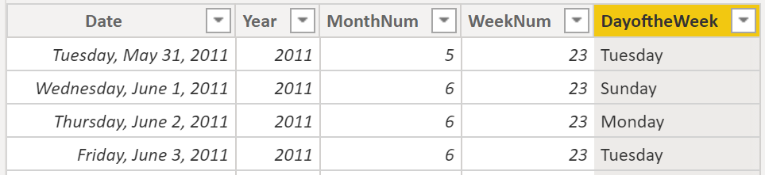
Create a Dates Table
Standardize on date formats and ranges that meet company requirements.

Slide 16
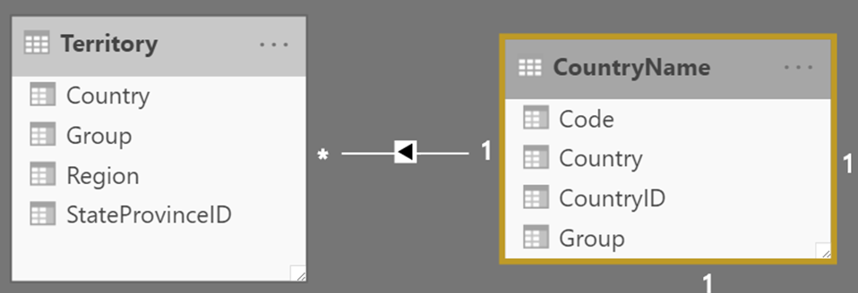
Relationship Cardinality
Cardinality: Uniqueness of data values in a column.
Relationship Cardinality : Number of related rows for each of the two objects in the relationship.
These rows are related based on relationship among the columns in underlying tables.
This relationship can be
One to one
One to many
Many to many
Relationship cardinality refers to the number of rows from one table (one or many) that are related to another (one or many).

Slide 17
Knowledge Check
Q01 – What is cardinality?
Cardinality is the measure of unique values in a table.
Cardinality is the granularity of the data.
Cardinality is how long it takes for the data to load.
Cardinality is a type of visual element.
A01 - A
Q02 –What is relationship cardinality?
Cross-filter direction between the two objects in the relationship.
Number of related rows for each of the two objects in the relationship.
Number of related columns for each of the two objects in the relationship.
A02 - B

Slide 18
Lesson 3: Dimensions and Hierarchies

Slide 19
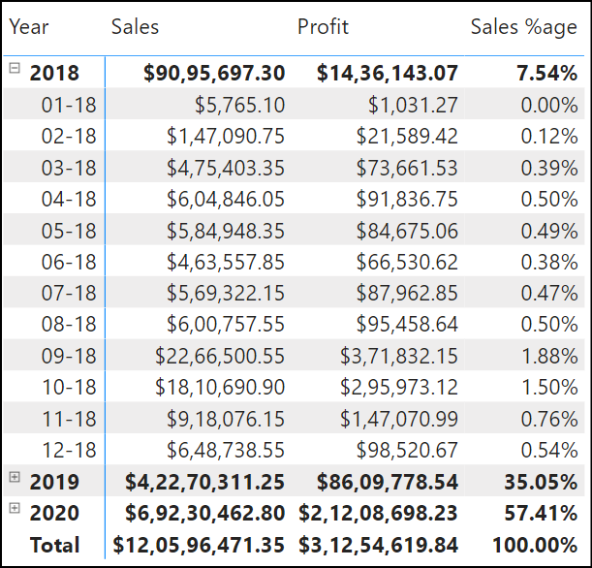
Hierarchy
A hierarchy is a set of fields categorized in a hierarchical way that one level is the parent of another level.
Values of the parent level can be drilled down to the lower level.

Slide 20
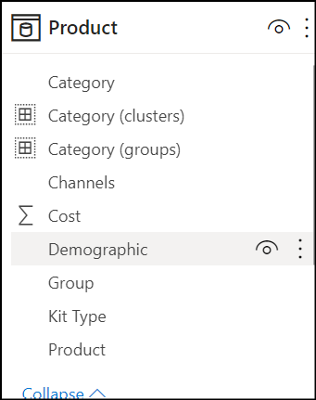
Dimensions
Store details about business entities.

Slide 21
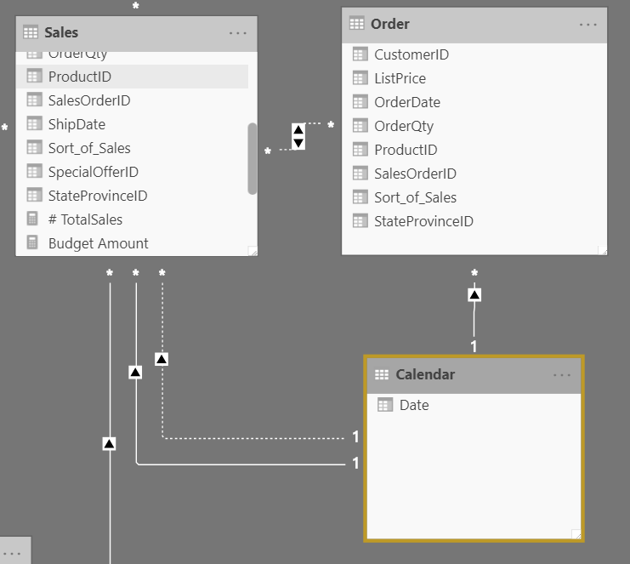
Role Playing Dimensions
A dimension that can filter related facts differently.
The date dimension table has three relationships to the sales facts. The same dimension table can be used to filter the facts by order date, ship date, or delivery date.

Slide 22
Knowledge Check
Q01 – What do you call a dimension that can filter related facts differently is called what?
Role Playing Dimension
Granular Dimension
Principal Dimension
A01 - A
Q02 –What type of table stores details about business entities?
Fact table
Dimension table
A02 - B

Slide 23
Lab 02: Model Data in Power BI Desktop
In this lab, you will commence developing the data model. It will involve creating relationships between tables, and then configuring table and column properties to improve the friendliness and usability of the data model.

